Slide 1
Introduction to CI/CD Pipelines
Adam Cook

Slide 2
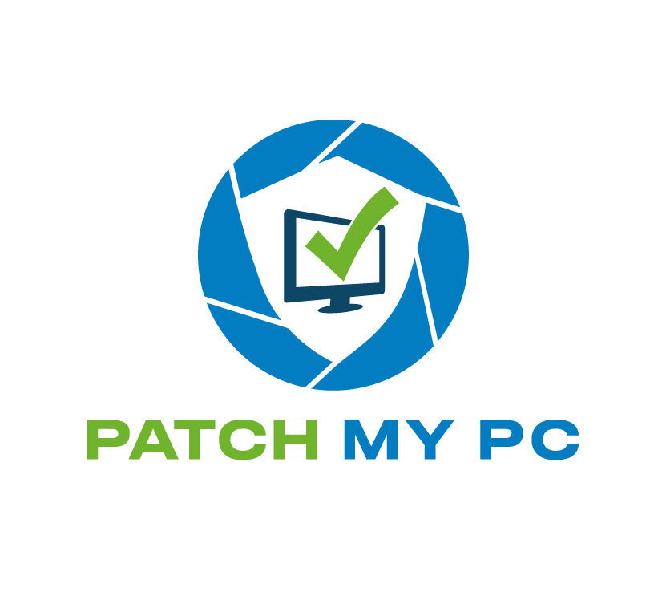

Many thanks to our sponsors!

Slide 3


Adam Cook
Customer Engineer @ Patch My PC
PowerShell, ConfigMgr, and Azure
PowerShell Southampton (pssouth.co.uk)

Slide 4
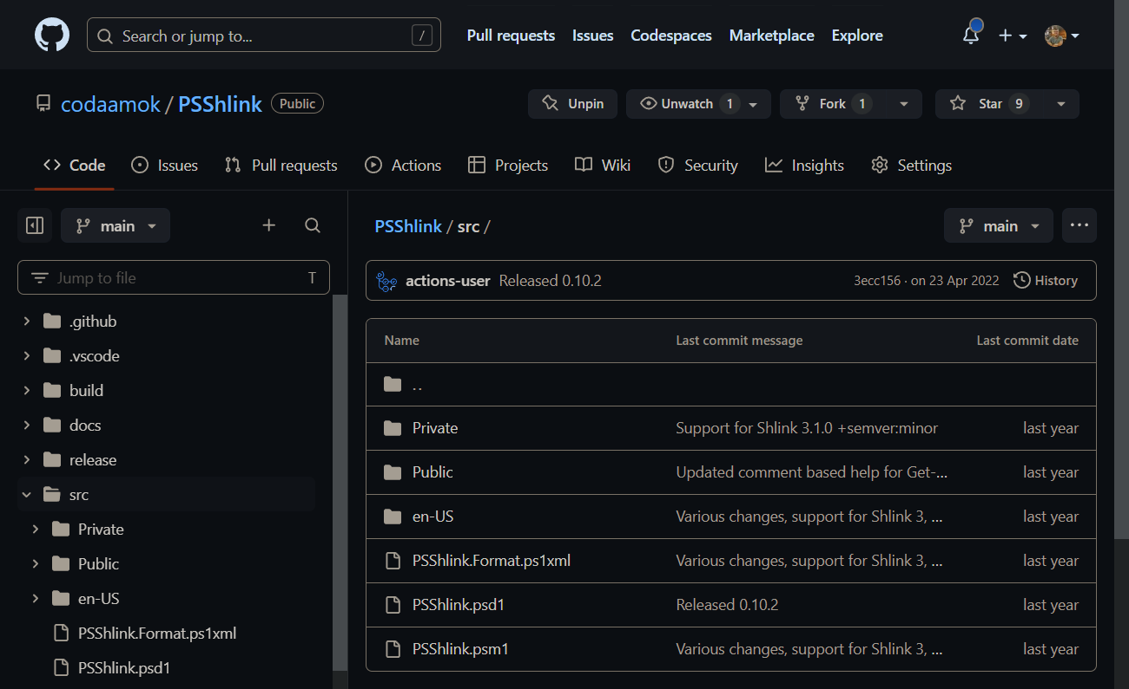
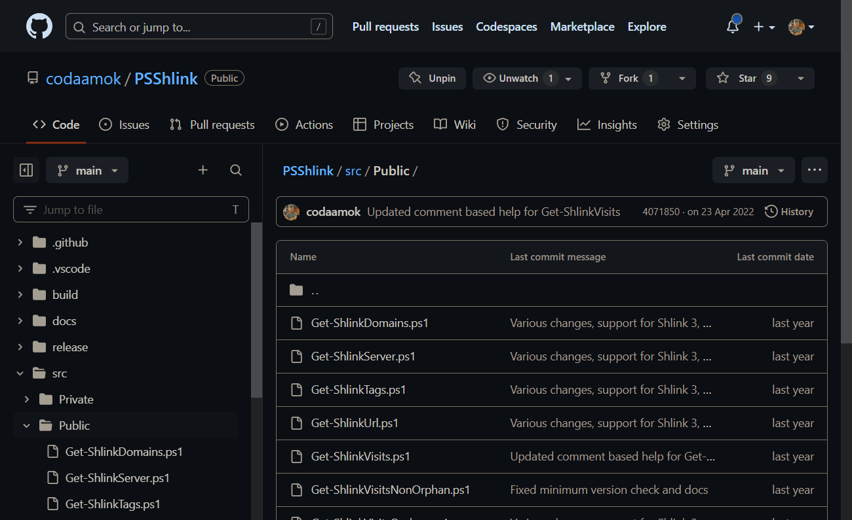
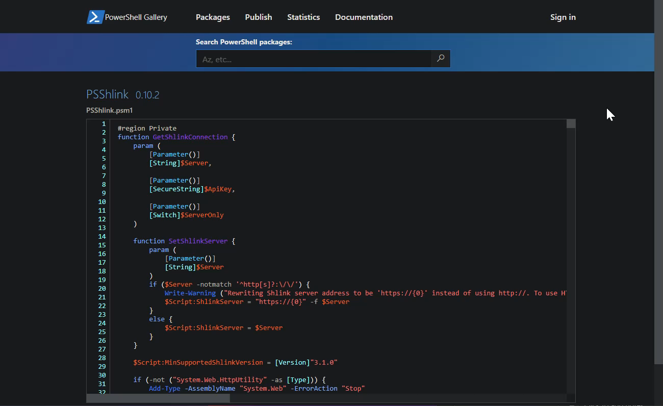

Introduction to CI/CD Pipelines
Continuous Integration and Continuous Deployment or Continuous Delivery
Approval
Pipeline
CI
CD
Make change to code, check into source control
Build
Test
Deploy to production

Slide 5


Slide 6
Why?
Feel liberated
“What’s the next version number?”
“!@#?, I forgot the release notes”
“How do I use Publish-Module again?”
“What tests do I need to do again?”
Reduce risk of abandonment
You’ve automated something, so automate deployment!
Consistent artefacts
Lower the barrier for contribution

Slide 7

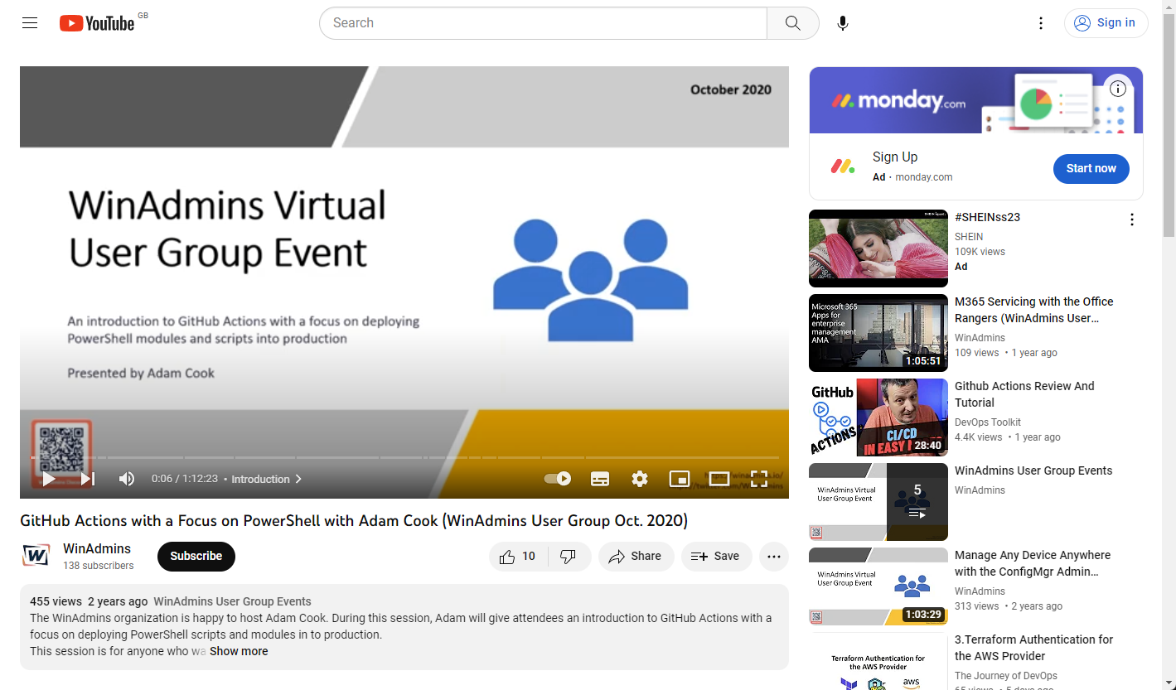
Services – “CI runners”
GitHub Actions
Azure DevOps Pipelines
Harness.io
Octopus Deploy (?)
Jenkins
acook.io/2020githubactions

Slide 8

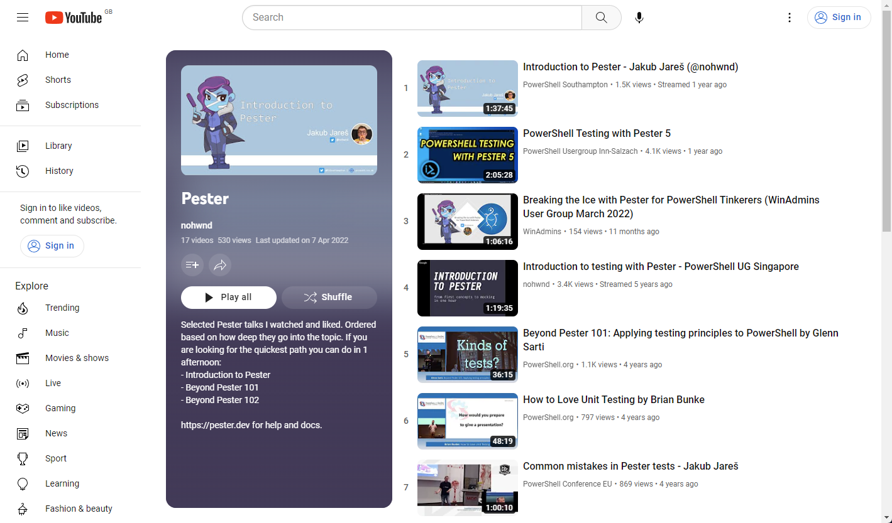
Community modules
Pester
PSScriptAnalyzer
InvokeBuild
psake
ModuleBuilder
Sampler
platyPS
acook.io/pesterplaylist

Slide 9
codaamok.build
Rough overview of its process

Slide 10
Demos
We love Demos!

Slide 11
Q&A
15 minutes

